Slide 1
Depth-first Traversal
For grid based area coverage

Slide 2
Depth-first search on a graph

Slide 3
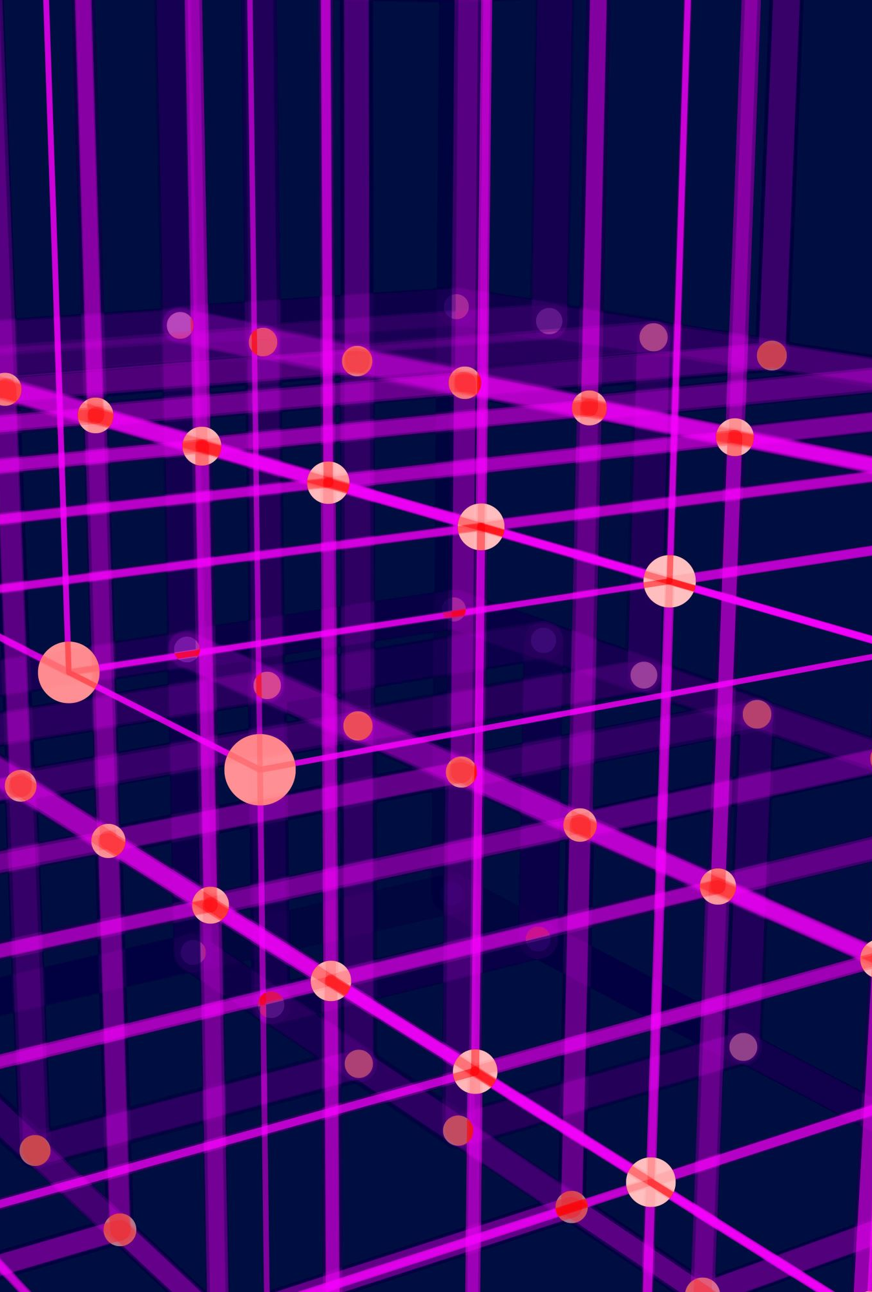
DFS
The main strategy of depth-first search is to explore deeper into the graph whenever possible.
Depth-first search explores edges that come out of the most recently discovered vertex, s. Only edges going to unexplored vertices are explored.
When all of s’s edges have been explored, the search backtracks until it reaches an unexplored neighbor.
This process continues until all of the vertices that are reachable from the original source vertex are discovered. If there are any unvisited vertices, depth-ﬁrst search selects one of them as a new source and repeats the search from that vertex.

Slide 4
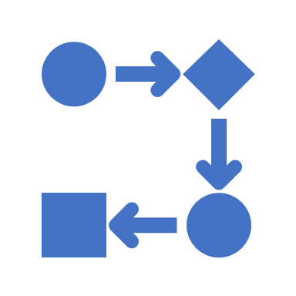
Backtracking
An algorithmic-technique for solving problems recursively by trying to build a solution incrementally, one piece at a time, removing those solutions that fail to satisfy the constraints of the problem at any point of time.

Slide 5
Description
A lawnmower has to reach every point of the lawn except for the obstacles.
The grid is a square and surrounded by wall.
The layout is unknown.

Slide 6
The lawn-mower
It searches for uncut grass in a clock wise direction.
The lawn-mower pushes the coordinates of each cells that are already visited into a stack.
At every unvisited cell it cuts the grass and than searches for another field.
When reaches a point(node) where there is no unvisited cell nearby, it goes back in the same way it used to came there, until reaches another unvisited cell.
Backtracking happens by poping the coordinates from the stack.
It finishes at the starting point when the stack gets emptied and there is not any unvisited neighboring cell.

